Slide 1

CUSTOMER SEGMENTATION USING MACHINE LEARNING
GITAM SCHOOL OF TECHNOLOGY
(DEEMED TO BE UNIVERSITY)
Department OF CSE
BANGLORE 561203
Done by :
G. Vishnu Sai 321810301045
Under the guidance of
Dr. Chethana Tukkoji
Assistant Professor

Slide 2
CONTENTS:
ABSTARCT
LITERATURE SURVEY
INTRODUCTION
CUSTOMER SEGMENTATION
PROBLEM STATEMENT
PROCESS
WORKING METHODOLOGIES
PRE-PROCEDURES
K-CLUSTER ALGORITHM
DATA SET
ADVANTAGES AND DISADVANTAGES
CONCLUSION
REFERENCES

Slide 3
ABSTARCT:
Ecommerce transactions are no longer a new thing. Many people shop with ecommerce and many companies use ecommerce to promote and to sell their products. Because of that, overloading information appears on the customers’ side. Overloading information occurs when customers get too much information about a product then feel confused. Personalization will become a solution to overloading problem. In marketing, personalization technique can be used to get potential customers in a case to boost sales. The potential customer is obtained from customer segmentation or market segmentation.

Slide 4
LITETATURE SURVEY
Paper | Method | Data | Advantages | Disadvantages
Magento (2014) | Magento | Demographic Purchase history , Data Product , Data Media , Data Marketing , server log | Have Cleared Variable Customer Segmentation | There is no data pre-processing for each variable
Baer (2012) | Business Rule | Demographic Purchase history | Easy to apply , use database query | Not focused on customer behaviour
Colica (2011) | Customer Profiling | Demographic Purchase history | Use database query if data is small | Not focused on customer behaviour

Slide 5
Cont..
Paper | Method | Data | Advantages | Disadvantages
Baer (2012) | Supervised clustering with decision tree | Demographic Purchase history | Classify customers according to target | Use only one variable to cluster
Baer (2012) | Unsupervised clustering | Purchase history | Use any number of customer attributes | Speed of computation depends on K values
Colica (2011) | Purchase affinity clustering | Purchase history , Data product | Know the product most in demand | Specific to product segmentation

Slide 6
INTRODUCTION
Customer segmentation is the practice of dividing a company's customers into groups that reflect similarity among customers in each group. The goal of segmenting customers is to decide how to relate to customers in each segment in order to maximize the value of each customer to the business

Slide 7
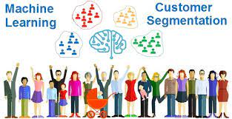
WHAT IS CUSTOMER SEGMENTATION ?
Customer segmentation is the practice of dividing a company's customers into groups that reflect similarity among customers in each group.
Fig.1: customer segmentation

Slide 8
PROBLEM STATEMENT
Customer segmentation is a technique in which we divide the customers based on their gender, age, annual income, spending score, etc. It is useful to get this information so that the store can get help in personalize marketing and provide customers with relevant deals. With the help of this project, companies can run user-specific campaigns and provide user-specific offers rather than broadcasting same offer to all the users.

Slide 9
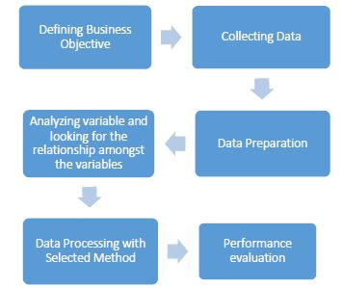
PROCESS
Fig. 2: process

Slide 10
WORKING METHODLOGIES
Customer segmentation Dataset is taken.
The data is preprocessed to clean the data and understand the dataset.
The preprocessed data is divided as training and testing data.
The model is built using machine learning algorithms like Logistic Regression
The model is trained using training dataset and once the model has been trained successfully it has to be tested.

Slide 11
Cont..
The trained model is tested using testing dataset and accuracy is calculated.
The algorithm which gives the best accuracy is taken as our final prediction model.
The finalized model is converted into pickle model (binary format data) and saved.
Finally, the predicted output is displayed on the jupyter notebook.

Slide 12
PRE-PROCEDURES
We are doing the segmentation using machine learning algorithms like logistic regression and K-clustering while also making use of prominent Python Libraries such as sklearn etc.
We used jupyter notebook for execution.
Data set for processing
Some set of python libraries like pandas, NumPy , matplotlib ,seaborn .
Hardware tools like i3 processors.
Software Tools like Python 3.7+ version.

Slide 13
K-CLUSTER’S ALGORITHM
The k-means algorithm for partitioning, where each cluster’s center is represented by the mean value of the objects in the cluster.
Input: k: the number of clusters,
D: a data set containing n objects.
Output: A set of k clusters

Slide 14
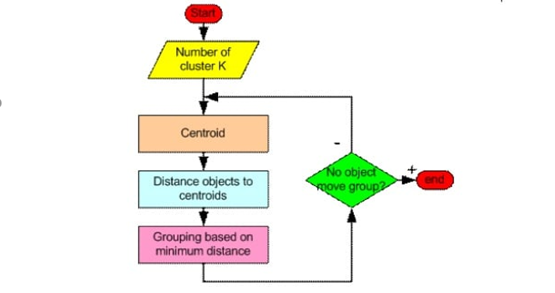
HOW K-MEAN CLUSTERING ALGORITHM WORKS?
Fig.3: flowchart

Slide 15
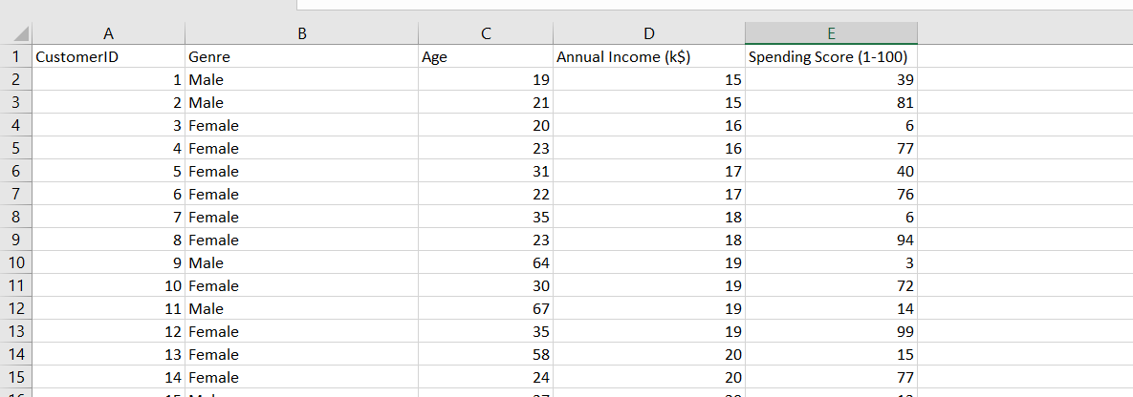
DATA SET FOR CUSTOMER SEGMENTATION
Fig.4: data set

Slide 16
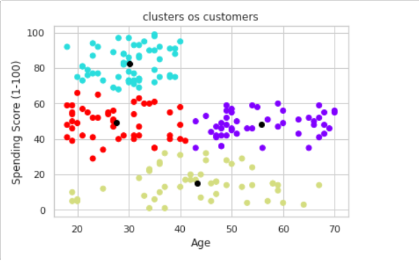
RESULT & ANALYSIS
Predicted output for mall customer.
Fig.5: result

Slide 17
ADVANTAGES
Budgeting
Product Design
Promotion
Marketing
Customer Satisfaction

Slide 18
DISADVANTAGES
Limited Production
Expensive Production
Heavy Investment
Promotion Problems

Slide 19
CONCLUSION
Customer segmentation is a way to improve communication with the customer, to know the wishes of the customer, customer activity so that appropriate communication can be built. Finding an optimal number of unique customer groups will help you understand how your customers differ, and help you give them exactly what they want. Customer segmentation improves customer experience and boosts company revenue. That’s why segmentation is a must if you want to surpass your competitors and get more customers. Doing it with machine learning is definitely the right way to go.

Slide 20
REFERENCES
[1] Al-Qaed F, Sutcliffe A. Adaptive Decision Support System (ADSS) for B2C E-Commerce. 2006ICEC Eighth Int Conf Electron Commer Proc NEW E-COMMERCE Innov Conqu Curr BARRIERS, Obs LIMITATIONS TO Conduct Success Bus INTERNET. 2006:492-503.
[2] Mobasher B, Cooley R, Srivastava J. Automatic Personalization Based on Web Usage Mining. Commun ACM. 2000;43(8).
[3] Cherna Y, Tzenga G. Measuring Consumer Loyalty of B2C e-Retailing Service by Fuzzy Integral: a FANP-Based Synthetic Model. In: International Conference on Fuzzy Theory and Its Applications iFUZZY.; 2012:48-56.
[4] Magento. An Introduction to Customer Segmentation. 2014. info2.magento.com/.../ An_Introduction_to_Customer_Segmentation...
[5] Baer D. CSI : Customer Segmentation Intelligence for Increasing Profits. SAS Glob Forum. 2012:1-13.
[6] Colica R. Customer Segmentation And Clustering Using SAS Enterprise Minner Part I The Basics. 2011:1-14.
[7] Venkatesan R. Cluster Analysis For Segmentation. 2007.

Slide 21


